Slide 2
SMART INNOVATION HACKATHON 2023
TRAILBLAZER SQUAD IDEA PRESENTATION

Slide 3
SIH ID : 1313
PROBLEM STATEMENT : A system of IoT Devices to prevent under-loading / overloading of Railway wagons..
PROBLEM DESCRIPTION :
CIL has been supplying coal to its consumers by Rail through Railway Sidings. The railway wagons at such sidings are loaded through contractual means by payloader. The loading of wagons by contractual arrangement often results in overloading or underloading Railway wagons. The rules of Penal overloading and underloading are notified by Railway. Any penalty for overloading charged by the Railway for any consignment is payable by the purchaser. However, in case of underloading of wagons, credit for idle freight is adjusted in coal bills. Thus any idle freight for under-loading is borne by CIL. During 2021-22, the expense for under-loading was nearly Rs.593 Cr. whereas the contract for wagon loading itself was only Rs.276 Cr. Hence, a digital solution in the form of sensor/ IoT is needed to prevent the under-loading and overloading of Railway wagons.

Slide 4
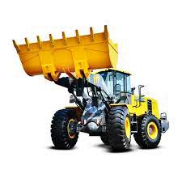
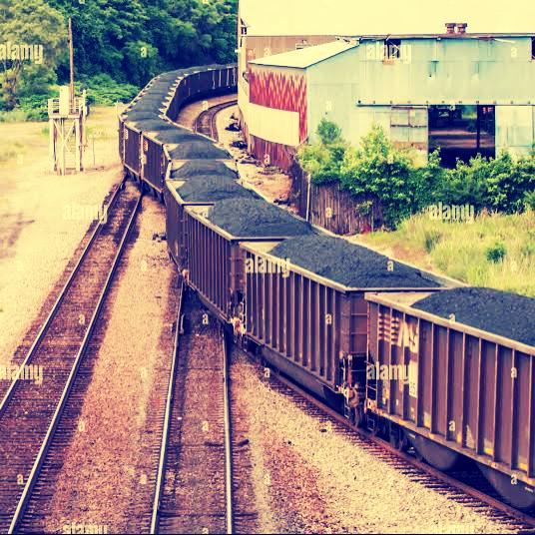
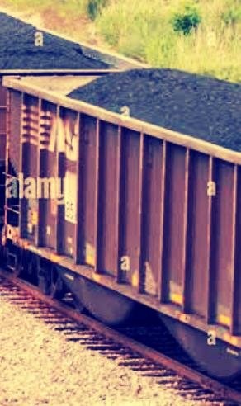
PAYLOADER & WAGONS

Slide 5
COMPONENTS REQUIRED TO SOLVE THE PROBLEM
Compression weight sensor/ load cell
Arduino Uno
LCD
Metal with pay loader shaper connected springs
Connecting wires
Buzzer

Slide 6
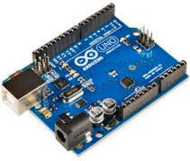
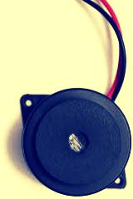
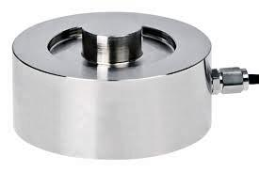
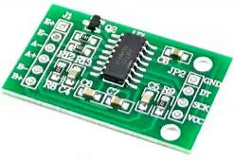
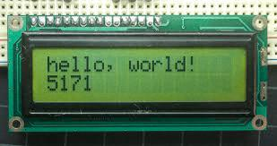

Slide 7
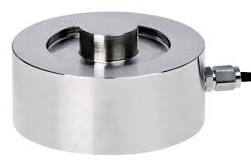
WEIGHT SENSOR: A weight sensor is a transducer that converts force or weight into an electrical signal. It typically consists of a strain gauge circuit mounted on a flexible structure. When a force is applied, the strain gauge deforms, altering its electrical resistance. This change in resistance is measured and converted into a weight value. Load cells are commonly used in scales and industrial applications for precise weight measurements. They come in various types and capacities to suit different needs, from small kitchen scales to heavy-duty industrial systems.

Slide 8

HX711 : The HX711 is an amplifier and analog-to-digital converter (ADC) module designed for load cell and strain gauge applications. >> The HX711 is a specialized IC used to interface load cells and strain gauges with microcontrollers like Arduino. >>It provides high-precision analog-to-digital conversion and amplification for accurate weight measurements. >>It can handle load cell inputs with various sensitivity levels and offers adjustable gain settings.

Slide 9
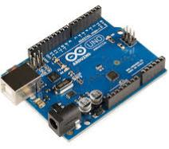
AURDINO: Arduino is an open-source platform for creating electronics projects. It consists of a microcontroller board (e.g., Arduino Uno) and a user-friendly integrated development environment (IDE). Users can write and upload code to the board to control various hardware components like LEDs, sensors, and motors. Arduino simplifies electronics prototyping with a vast community and extensive libraries, making it accessible for both beginners and advanced makers. It’s commonly used for robotics, home automation, and interactive art projects.

Slide 10
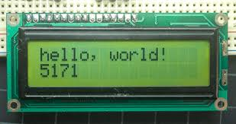
LCD:
An LCD, or Liquid Crystal Display, is a flat-panel technology commonly used for displaying information in devices like TVs, computer monitors, and digital watches. It works by manipulating liquid crystals to control the passage of light, producing images and text on a screen.

Slide 11
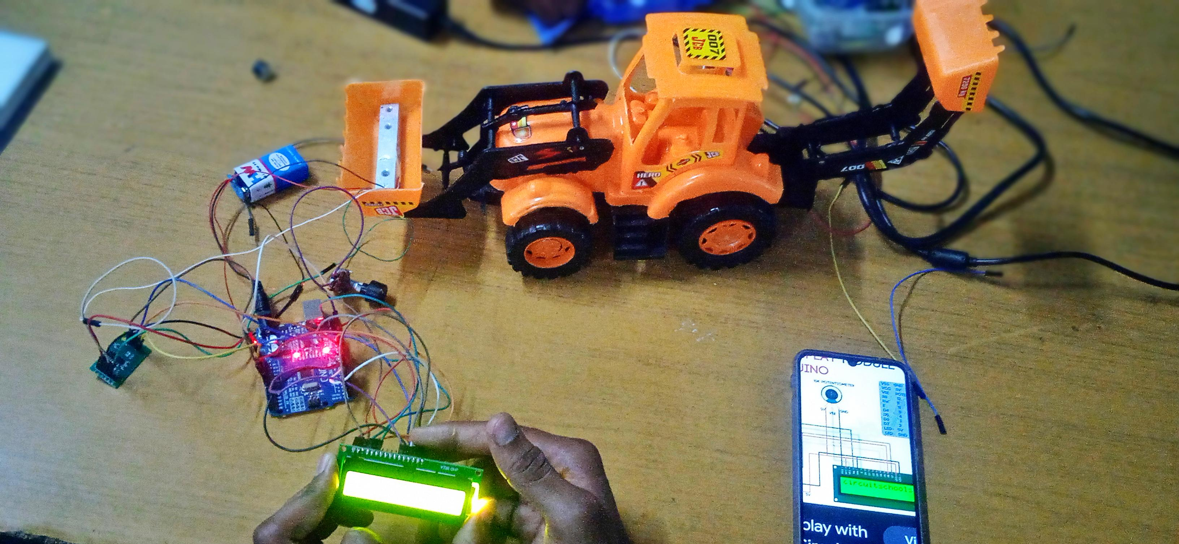

Slide 12
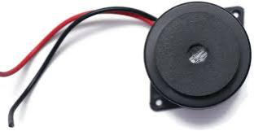
BUZZER:
A buzzer is an electronic component that generates sound when an electrical current passes through it, producing a distinct audible tone or noise. Buzzer modules are often used in electronic circuits and devices for alarms, notifications, or simple sound effects.

Slide 13
ADVANTAGES OF PROJECT:
It controls overloading and underloading
It is less expensive
Easy to implement

